Slide 1
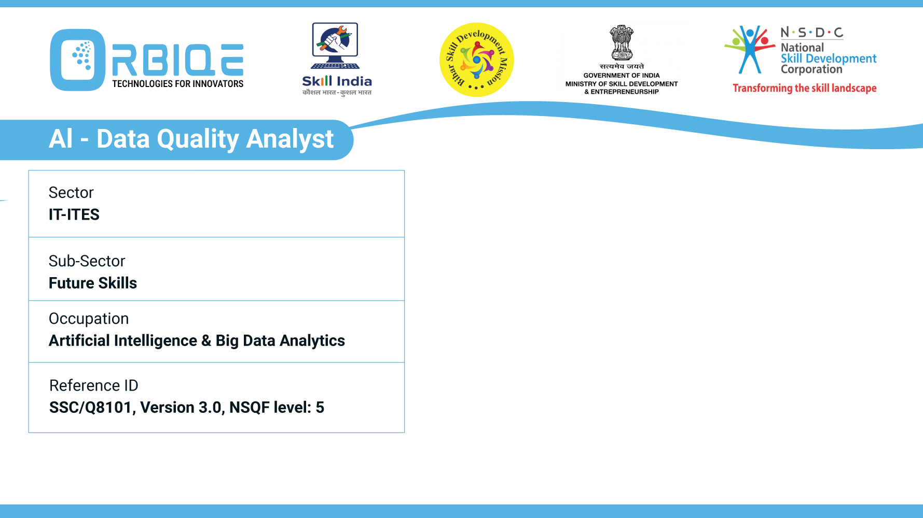
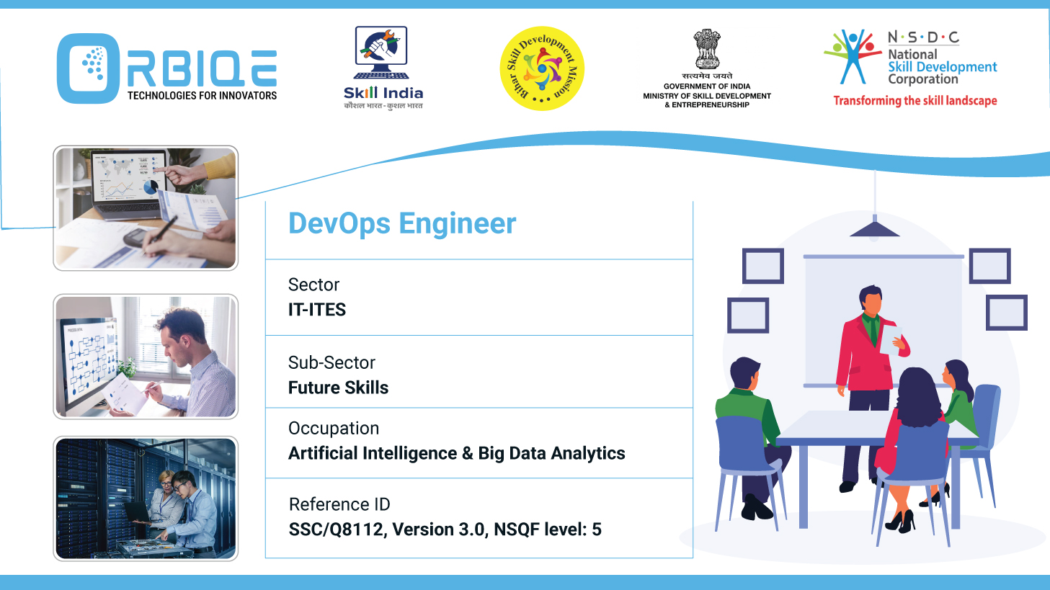
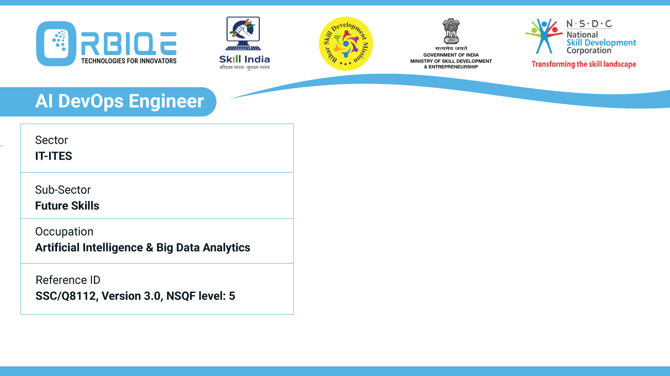
Name- Krishna Kant Dubey

Slide 2

RStudio

Slide 3
Agenda
Apply basic functions and libraries present in statistical software packages and IDEs
Use statistical pack ages, frameworks and libraries such as NumPy and Pan das for developing applications

Slide 4
In RStudio (Using R Language)
Load and Inspect Data
Use Basic Functions
Visualization with ggplot2
Data Manipulation with dplyr
Why Use NumPy and pandas in Applications

Slide 5
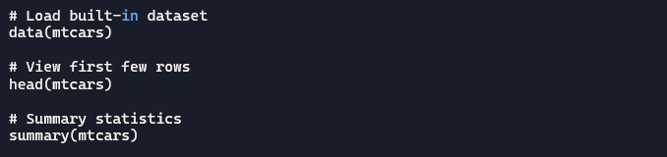
Load and Inspect Data

Slide 6
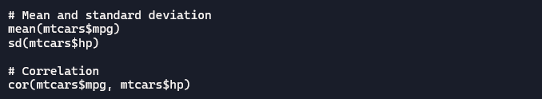
Use Basic Functions

Slide 7
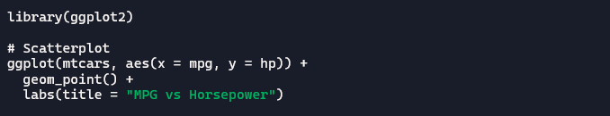
Visualization with ggplot2

Slide 8
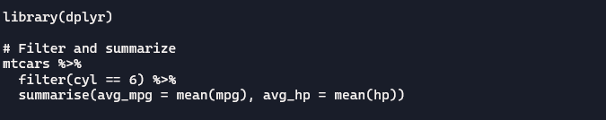
Data Manipulation with dplyr

Slide 9
Why Use NumPy and pandas in Applications
Library | Role in Applications
NumPy | Fast numerical computations, array manipulation, linear algebra, random number generation
pandas | Data ingestion, cleaning, transformation, and tabular data management

Slide 10
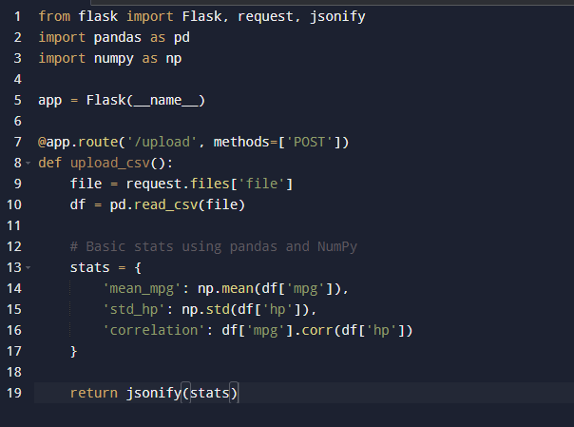
Data-Driven Flask Web App
Imagine a Flask app that accepts CSV uploads and returns insights

Slide 11
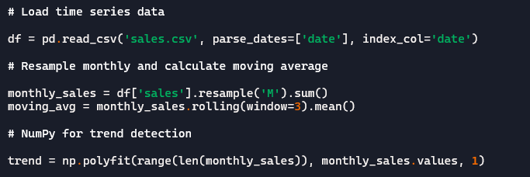
Time Series Forecasting App
Use pandas for time series indexing and NumPy for calculations.

Slide 12
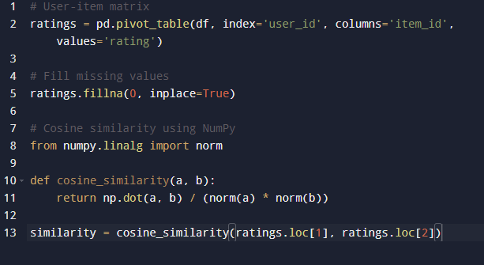
ML-Powered Recommendation System
Preprocess data with pandas, compute similarity with NumPy

Slide 13
Thank You

